Slide 1

Client-side JavaScript
CITS3403 and CITS5505 - Agile Web Development
Unit Coordinator: Matthew Daggitt
2024, Semester 1

Slide 2
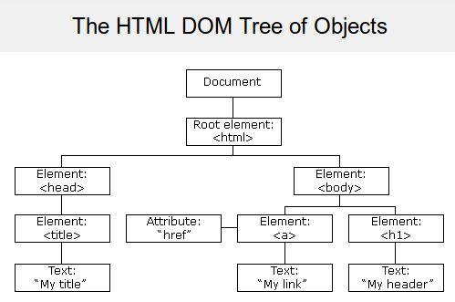
What is the USP of JavaScript?
We've seen core JavaScript that provides a general scripting language.
But why is JavaScript so useful for the web?
Client-side JavaScript adds collection of objects, methods and properties that allow scripts to interact with HTML documents
Dynamic documents
Client-side programming
This is done by bindings to the Document Object Model (DOM)

Slide 3
The Document Object Model (DOM)
Notes:
3

Slide 4
The Document Object Model
“The Document Object Model is a platform- and language-neutral interface that will allow programs and scripts to dynamically access and update the content, structure and style of documents.”
“The document can be further processed, and the results of that processing can be incorporated back into the presented page.”
DOM specifications describe an abstract model of a document
API between an HTML document and a program
Interfaces describe methods and properties
Different languages will bind the interfaces to specific implementations
Data is represented as properties and operations as methods
See https://www.w3schools.com/js/js_htmldom.asp for more details

Slide 5
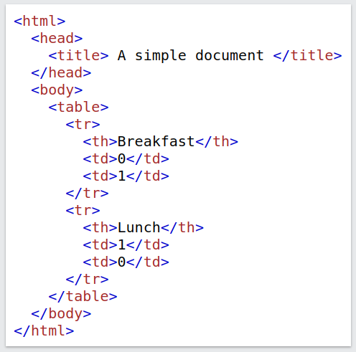
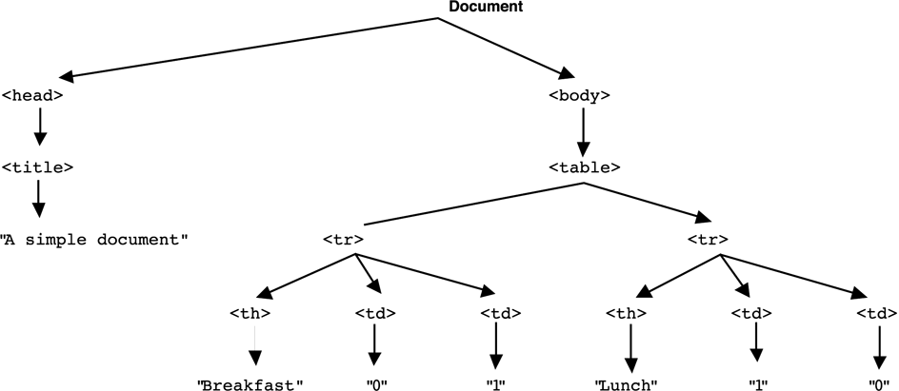
The DOM Tree Model
DOM API describes a tree structure
The "document" node reflects the hierarchy in the HTML document

Slide 6
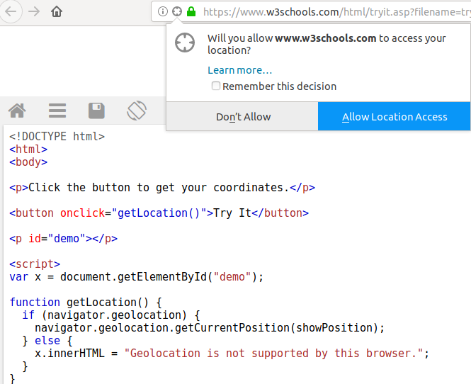
The BOM Execution Environment
However, the DOM tree is just one subsection of a larger Browser Object Model (BOM) tree that also includes nodes for the execution environment in a browser.
This is not specific to the current page (document) being rendered and includes:
Type of browser
User’s history
Cookies
Screen size
Geolocation
Local (browser) storage
Unlike the DOM, the BOM is not supported by a fixed standard, but there is a common set of features most browsers support, to let developers tailor apps for different browser contexts.

Slide 7
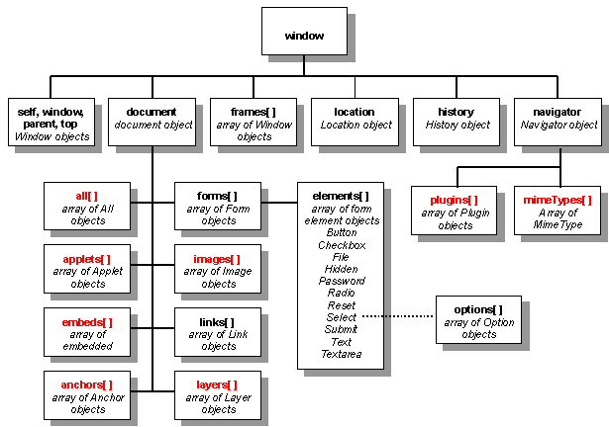
The full BOM tree
Source: tech.irt.org

Slide 8
The DOM in JavaScript
Notes:
8

Slide 9
The DOM in JavaScript
Elements in the HTML document are bound to JavaScript objects, known as element objects.
Attributes of the elements become named properties of element objects
For example, the object representing the HTML node:
will have two properties
type property will have value “text”
name property will have value “address”
Element objects can be addressed in several ways:
by type and position (e.g. the 5th image on the page)
by name
by id

Slide 10
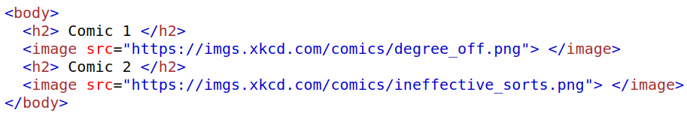


Method 1: Accessing elements by type & index
The document object has various properties that reference array-like objects containing all the elements in the document of a certain type, (e.g. forms, images, links, ...). For example, in
the element objects for the two images can respectively be accessed via:
Alternatively, the more general method is getElementsByTagName. For example:
will return all <p> elements inside the node represented by the element object x.

Slide 11
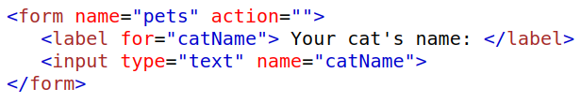

Method 2: Accessing elements by name
Adding a name attribute to an element allows you to access that element directly as a property of the parent element object. For example, in the following:
the input element can be accessed via:
For this to work all elements from the selected element up to, but not including, the original node must have a name attribute.
Names are often required for many other purposes (as keys for sending data to the server scripts, for linking with labels etc.), so this method is often convenient.

Slide 12
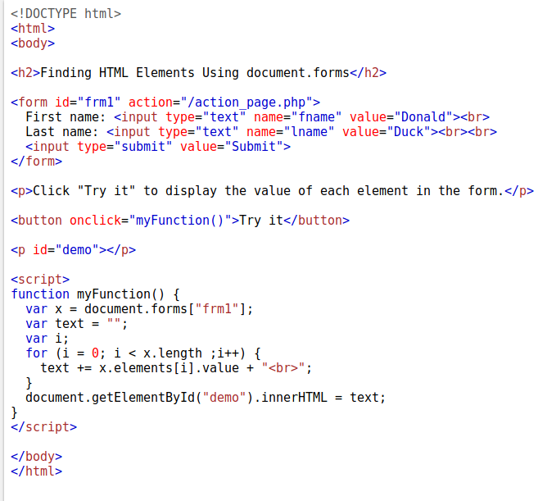
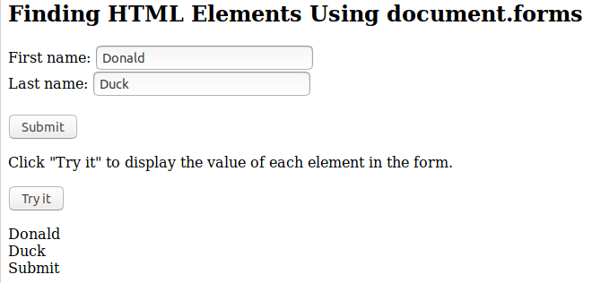
Method 3: Accessing elements by id
The method getElementById finds the element with same unique id attribute as the parameter.

Slide 13
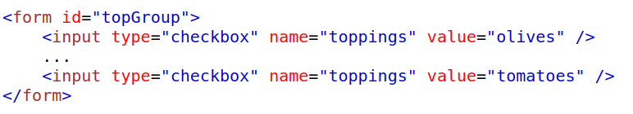
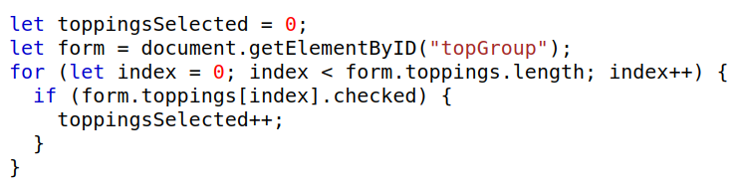
Element-specific access methods
There are a range of other element-specific methods for accessing the DOM,
e.g. checkboxes and radio buttons have an implicit array, which has their name as the array name

Slide 14
DOM traversal
As we've seen each element in an HTML document has a corresponding element object in the DOM representation.
So far, we've seen how to look up a particular element in a page with known structure.
How can we traverse the tree more abstractly without knowing the page structure?
Element objects have properties to support traversing the document tree:
parentNode references the parent node of the Element
previousSibling and nextSibling connect the children of a node into a list
firstChild and lastChild reference children of an Element
childNodes returns a NodeList (like an array) of children

Slide 15
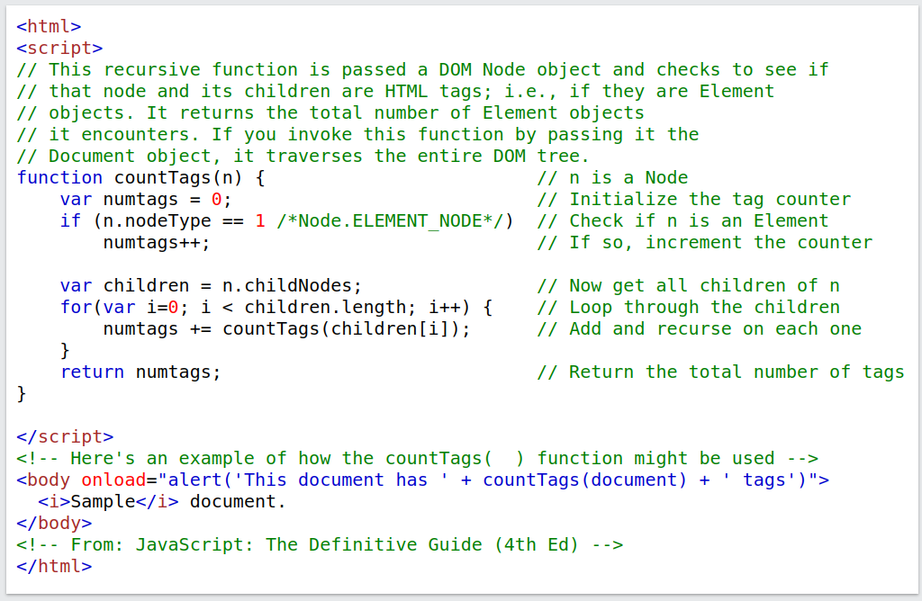
Example of traversing the DOM

Slide 16
DOM modification
There are also methods that allow you to modify or construct a DOM tree, e.g.
insertBefore inserts a new child of the target node
replaceChild will replace a child node with a new node
removeChild removes a child node
appendChild adds a node as a child node at the end of the children
This means you can construct part or whole document dynamically!
Document writing methods include:
open()
close()
write()
writeln()
This is how front-end frameworks like Angular or React dynamically build the entire document on the client side!

Slide 17
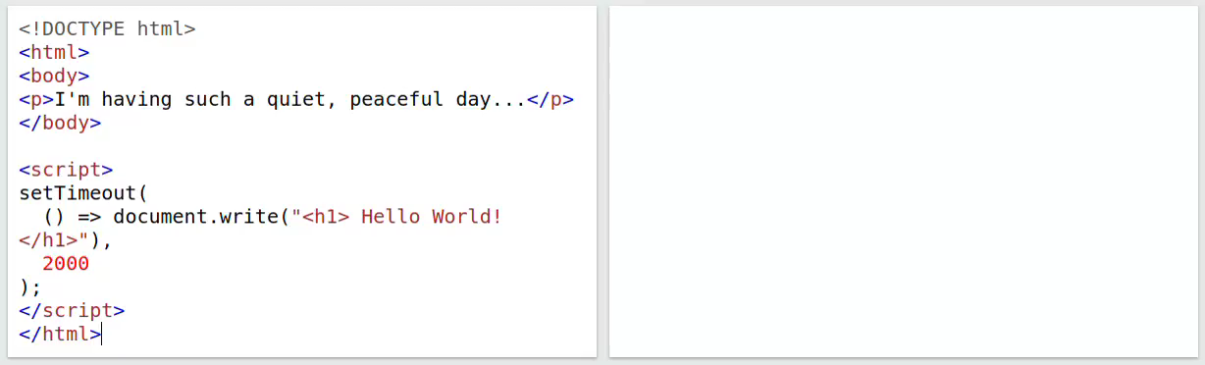
Example

Slide 18
The BOM in JavaScript
Notes:
18

Slide 19
The BOM tree
Source: tech.irt.org

Slide 20
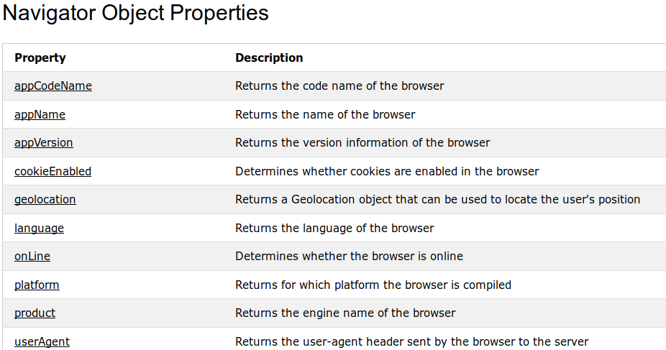
The Navigator object
The window.navigator object contains information about the browser:
Many such as geolocation need permission from the user to access...

Slide 21
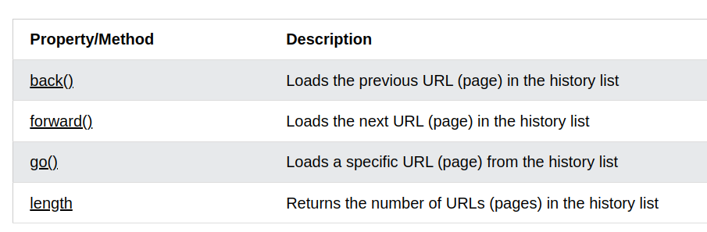
The History object
The window.history object contains methods for moving backwards and forwards
Many others such as:
Window.console
Window.screen
window.location.

Slide 22
Persistent state in the browser
By default, HTTP(S) requests are stateless – neither the server nor the client maintains information once the user navigates the away from the webpage.
This makes it difficult to identify returning users or maintain state between sessions.
There are two main ways one can store state: cookies and local storage:
A cookie is a string containing key-value pairs.
Local storage is a key-value dictionary where values are stored as strings.
Cookies are transmitted to the server as part of each HTTP request.
Local storage is by default only available on the client side.
Both are only available to pages within the same domain they created by.

Slide 23
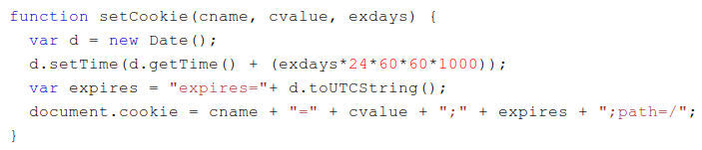
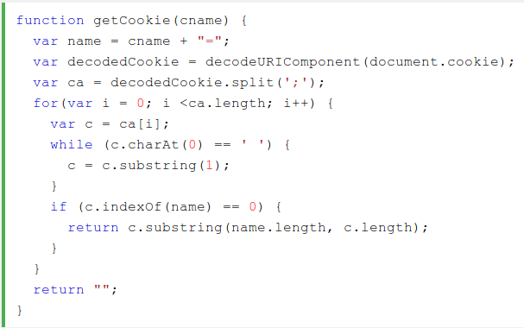
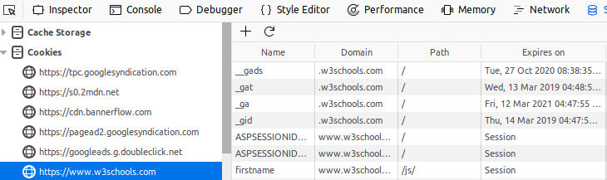
The Cookies object
A cookie is a small (max 4KB) text file containing key-value pairs.
Cookies for the current web-page are accessible through document.cookie.
Cookies are specified with an expiry date or will be deleted when the browser is closed.

Slide 24
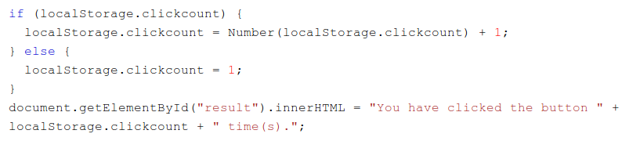
Web storage
A larger and more secure alternative to cookies is Web Storage.
Particularly useful for large forms where there is a chance a session could end before the user submits the form.
All values are automatically converted to strings internally.
Can store much more data than a cookie (10Mb)

Slide 25
Event-driven programming
Notes:
25

Slide 26
Event driven programmingc
Event-driven programming or event-based programming is:
a programming paradigm in which the flow of the program is determined by sensor outputs or user actions (mouse clicks, key presses) or messages from other programs
not unique to the web – crops up in many other places: hardware interrupts, multi-process operating systems, distributed programming, Java listeners, exceptions...
It is fundamental to web-based programming
client-server model
stateless programming
controlled from browser end
Event-driven programming drives many of the technologies we will cover in this unit:
Sockets
AJAX
JavaScript callbacks

Slide 27
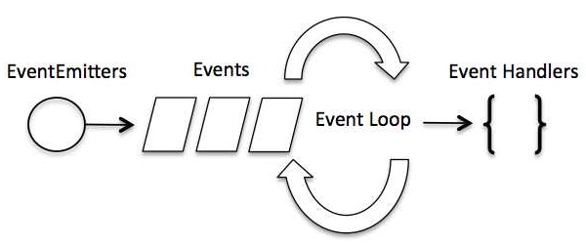
Implementing event-driven programs
Event-driven programs are usually structured as a program loop which consists of two parts:
event detection
event handling
e.g. an asynchronous program that polls for events from a keyboard
set counter K to 0 repeat { if a number has been entered (from the keyboard) { store in A[K] and increment K if K equals 2 print A[0]+A[1] and reset K to 0 } }
Event detection
Event handling

Slide 28
Avoiding implementing the event loop
The programmer may be freed from event detection (and hence managing the loop) in several ways:
embedded programs may use interrupts - handled by hardware (no loop needed)
the execution environment itself may implement the loop
Browsers use the second approach to allow the programmer to focus on event handling.
The browser listens (using polls or interrupts) for events, such as
user actions (e.g. <enter>, mouse clicks, ...)
server responses (e.g. page loaded, AJAX responses, calculation, ...)
When it recognises an event, it invokes the correct event listener, a piece of code to handle the event that accepts information about the event as required.
But how does the browser know what code to call?
For the browser to know what code to invoke for different actions, the event listener code must be registered to a specific event.

Slide 29
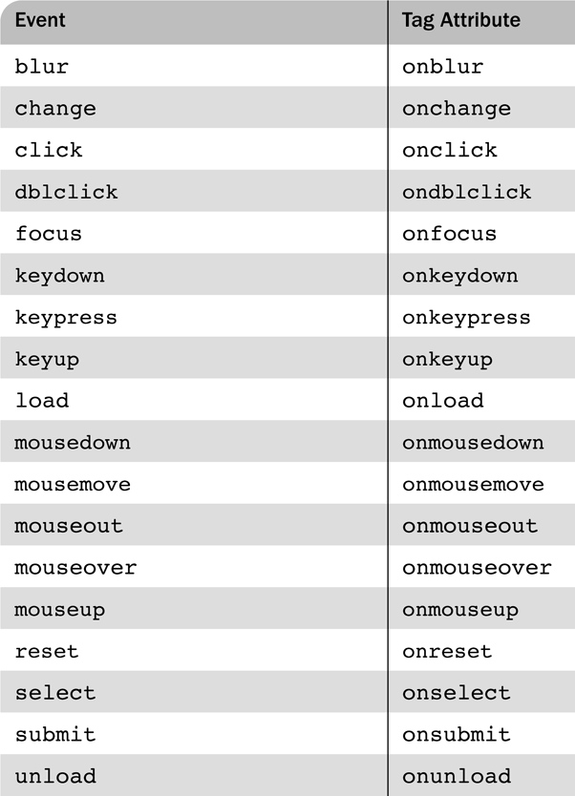
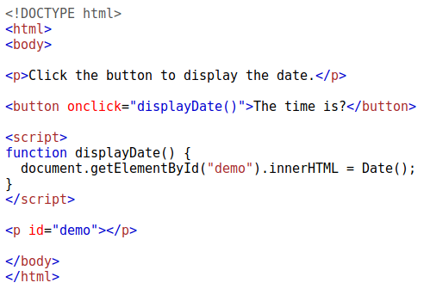
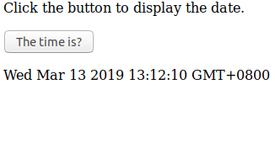
Common events and their tags

Slide 30

Event listener registration
There are three ways to register an event handler in HTML/JavaScript:
Assign the event handler script to an event attribute Usually the handler script is more than a single statement and called as a function:
Assign the handler to the appropriate property of the element’s object
Statement must follow both handler function and form element so the JavaScript interpreter has seen both.
Furthermore, unlike the 1st approach, we just provide a reference to the function rather than call the function directly.

Slide 31

Event listener registration
3. Use the addEventListener method to register a listener to an element object. The method takes three parameters:
a string naming the event type
the handler function,
an optional Boolean specifying if the handler is enabled for the capture phase (see next slide).
This last approach was added to JavaScript later, and should be used instead of the first two approaches because:
Separation of concerns, i.e. control code is kept separate from HTML.
Multiple handlers can be added to the same event for the same element.
In contrast to the first approach can add the same handler to many elements in a loop.

Slide 32
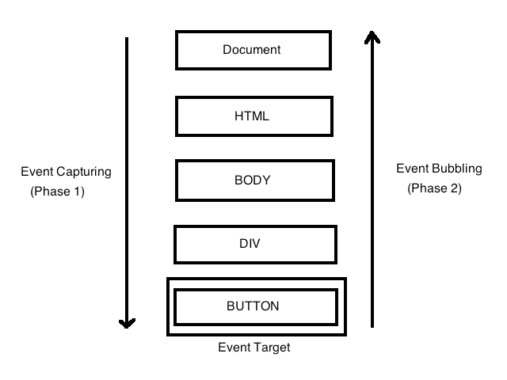
Event flow
The HTML element receiving an event is called the target node, however its ancestor nodes in the DOM tree will also receive the event. The order in which elements receive the event is called the event flow and has 3 phases:
In the capturing phase each node from the document root to the target node is examined in order. If the node is not the target node and there is a handler for that event at the node and the handler is enabled for capture for the node, the handler is executed.
In the target phase all handlers registered for the target node, if any, are executed.
In the bubbling phase each node from the parent of the target node to the root node, in order, is examined. If there is a handler for that event at the node and the handler is not enabled for capture for the node, the handler is executed.

Slide 33

Event objects
Handling the event in the bubbling phase is the default behaviour, i.e. child elements handle events first before parents.
Certain events do not bubble, e.g. load, unload, blur and focus
The event object is passed as an argument to every event handler:
The target property is the node to which the event is directed.
The currentTarget property is the node to which the handler is registered.
The stopPropagation method prevents an event from bubbling up to the parent.
Some event types will extend the interface to include information relevant to the subtype of event. For example, a mouse event will include the location of the mouse at the time of the event.

Slide 34
Some useful events
load – fires when the whole page has loaded, including all dependent resources such as stylesheets, scripts, iframes, and images.
mouseover/mousemove/mouseout - fires when the mouse enters/moves in/leaves an HTML element.
keydown - fires when a key is pressed.
focus/blur - fired when an HTML element gains/loses focus, i.e. cursor placed in text area, paragraph highlighted.

Slide 35
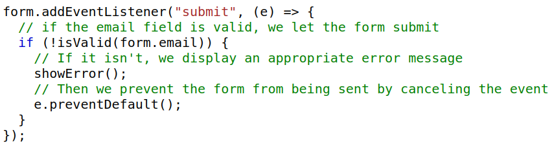
Using events to validate a form
An important use of events is to validate the content of forms, without using bandwidth and time to access a remote server.
By reacting the focus and input events the user can be prevented from entering invalid values in a text input field
By reacting to the submit event, the user can be prevented from submitting an invalid form.
Easy to work around, e.g.
Delete the validation code in the browser inspector panel
Simulate an HTTP request directly with socket-level programming
If the validity of data is important, the server needs to check it!

Slide 36
jQuery
Notes:
36

Slide 37
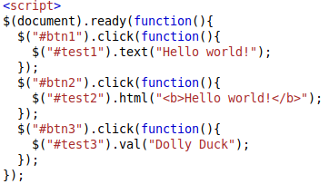
jQuery motivation
The core JavaScript DOM manipulation function names are verbose, composing them is hard and, back in the early days of web development, many useful functions were missing.
jQuery, which aims to address these problems, is the most popular JavaScript library in the world. It was built by John Resig in 2006 and is available on the MIT license.
The goal of jQuery is to make DOM manipulation and other client-side JavaScript code much more concise and easier to write.
The jQuery library has features for
HTML/DOM manipulation
CSS manipulation
HTML event handling
Effects and animations
AJAX message handling
Some utilities

Slide 38

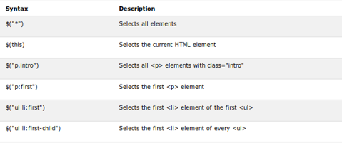
Getting started with jQuery
jQuery, like Bootstrap, is usually accessed through a CDN:
Basic jQuery syntax is $(selector).action(), where:
$ is an abbreviation for jQuery.
selector is a query to find HTML elements (syntax is a superset of CSS)
action is a jQuery function to be applied to the selected elements.

Slide 39



DOM element manipulation with jQuery
jQuery can select elements and classes in the DOM, traverse the DOM, get and set elements and attributes of the DOM, and add or remove elements.
The basic actions are:
text() - get or set the text
html() - get or set the raw html
val() - get or set the value of a field
attr() - get or set an attribute value.
If no value is passed, then they return the current value, e.g.
If arguments are passed, then they set the value.

Slide 40
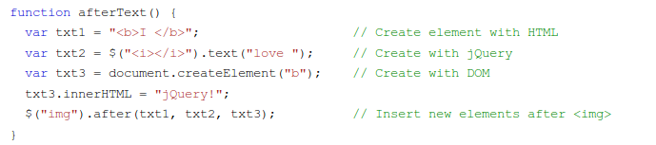
DOM tree manipulation with jQuery
You can also alter the DOM tree with the functions:
a.prepend(b1, b2, …)- adds b1, b2,... as the first child elements of a.
a.append(b1, b2, …)- adds b1, b2,... as the last child elements of a.
a.before(b1, b2, …)- adds b1, b2,... as the sibling before a.
a.after(b1, b2, …) - adds b1, b2,... as the sibling after a.

Slide 41
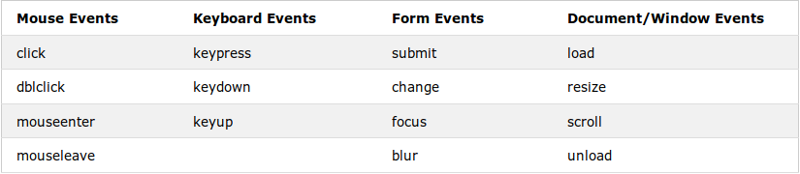

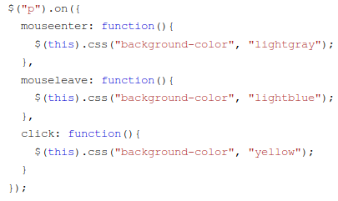
Events in jQuery
jQuery has various action functions to assign a JavaScript function to DOM events.
For example, to assign a click event to all paragraphs, we would use:
The on method allows multiple events to be assigned to a given selector.

Slide 42
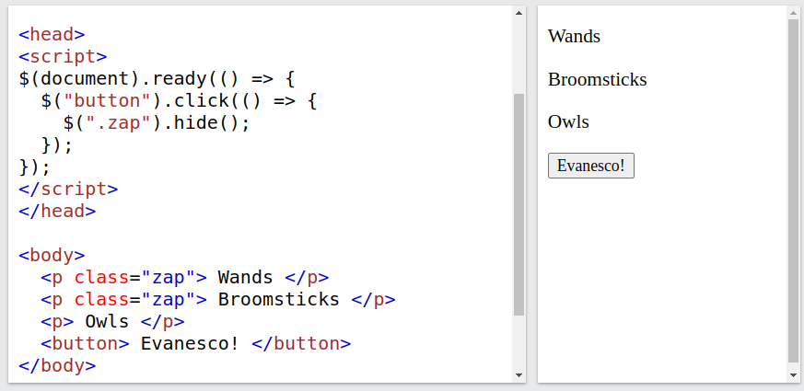
Delaying code in jQuery
jQuery events also include $(document).ready() to delay executing jQuery code until the document is fully loaded. It is common to wrap your jQuery code in this way.

Slide 43
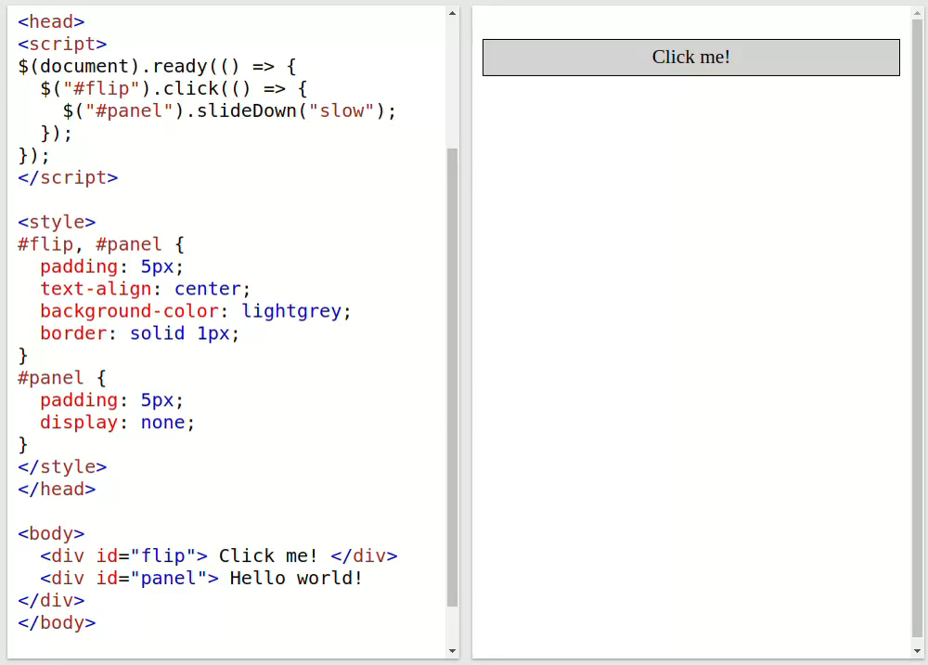
Effects in jQuery
Some jQuery actions implement useful effects, including hide, show, fade, slide and animate.

Slide 44
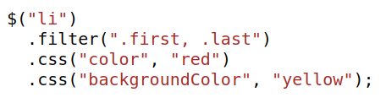
Chaining in jQuery
Most jQuery functions that mutate an element object, return that mutated element object instead of returning nothing.
Consequently, you can apply many effects to elements in a single statement. For example, in the code:
the following sequence of steps happens:
All <li> elements are selected.
Ones which don't belong to the "first" or "last" classes are filtered out.
The remaining ones have both their foreground and background colour set.
This style of programming is known as chaining.

